Slide 1
Notes:
Daily Edit

Slide 2
ENERGY
CFU 1
In your own words, what is energy?
Energy is the ____________________

Slide 3
ENERGY
CFU 1
In your own words, what is energy?
Energy is the ability to do work

Slide 4
LAW OF CONSERVATION OF ENERGY
Energy cannot be _______ or _________, it can only be _______ or _________

Slide 5
LAW OF CONSERVATION OF ENERGY
Energy cannot be created or destroyed, it can only be transferred or transformed.

Slide 6
FORMS OF ENERGY
Vocabulary
Energy – The ability to do work
Relate to real world
Can you give an example of something that has each of these types of energy?
Potential – stored energy that, when released, is converted to other forms such as kinetic, heat or light energy | Other
Gravitational Potential | Kinetic
Elastic potential | Heat
Chemical potential | Light
Nuclear potential | Sound
Electrical potential

Slide 7
GRAVITATIONAL POTENTIAL ENERGY

Slide 8
Success Criteria
CFU 1
What are we learning today?
Learning Intentions
Understand gravitational potential energy (GPE).
Define gravitational potential energy and provide examples.
Describe the concept of gravitational potential energy.
Explain how GPE changes with height and mass.
Calculate gravitational energy using: GPE or E_{p} = weight x height = mass x gravity x height

Slide 9
GRAVITY WHAT WE ALREADY KNOW
CFU 1
What is gravity?
Gravity is the force that attracts any objects with mass
Gravity is the force that holds us on the surface of the Earth and holds the Earth in orbit around the Sun

Slide 10
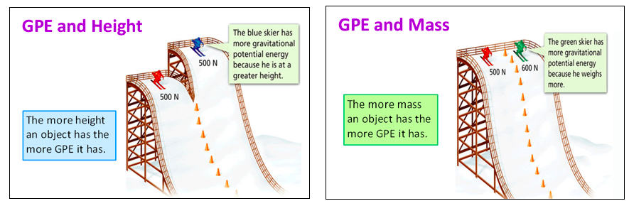
GPE

Slide 11
GRAVITY
CFU 1
How do we measure gravity?
CFU 2
What is the value of gravity on Earth?
Gravity is measured by the acceleration that it gives to freely falling objects
On Earth, the acceleration due to gravity is about 9.8 metres per second, per second (9.8 m/s²)
Notes:
9.8, 19.6, 29.4, 39.2 etc.

Slide 12
GRAVITATIONAL POTENTIAL ENERGY
Vocabulary
Gravity – The force that attracts any objects with mass
The formula that we use to calculate gravitational potential energy is:
CFU 1
What is the formula to calculate GPE?
GPE = m x g x h
CFU 2
What do each of the letters stand for?
gravity
(m/s²)
CFU 3
What are the units for each of the variables?
joules
(J)
mass
(kg)
height
(m)
Notes:
We don’t change g on Earth, but we can change GPE by changing either mass, height or both

Slide 13
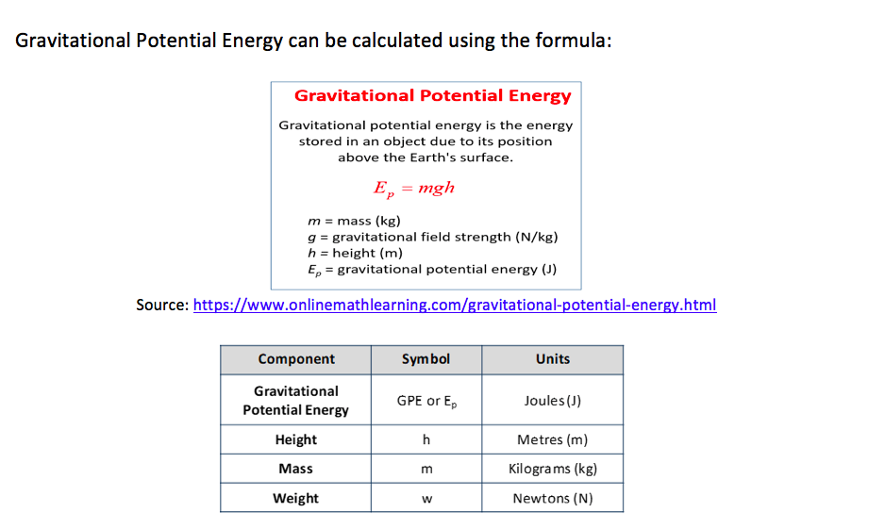

Slide 14
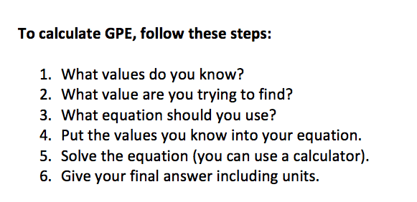

Slide 15
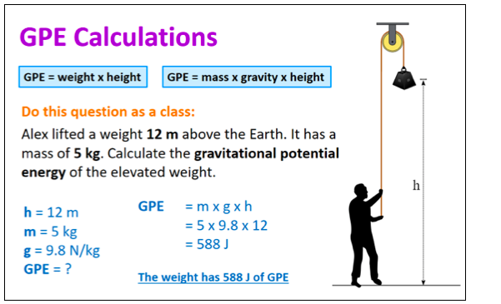

Slide 16
I’LL SHOW YOU
Process
Identify variables Check/convert units Write formula GPE=mgh Substitute values Calculate
An object on Earth has a mass of 5kg and is held 1m above the ground. What is its GPE?

Slide 17
LET’S PRACTICE
Process
Identify variables Check/convert units Write formula GPE=mgh Substitute values Calculate
An object on Earth has a mass of 4000g and is held 50cm above the ground. What is its GPE?

Slide 18
LET’S PRACTICE
Process
Identify variables Check/convert units Write formula GPE=mgh Substitute values Calculate
At the top of its arc, a ball with a mass of 1kg reaches a height of 4.5 metres. What is its GPE at this point?

Slide 19
LET’S PRACTICE
Process
Identify variables Check/convert units Write formula Substitute values Calculate
A silly teacher with a mass of 60kg swings from a vine and feels her hands slipping when she reaches a height of 4m. What is her GPE before she falls and breaks her back?

Slide 20
YOUR TASK
Use the formula’s provided to calculate GPE in the following situations.
Caden, who weighs 441 N, jumped from the 3 m diving board of a swimming pool. Calculate his GPE on the diving board.

Slide 21
Your task
If Lotte lifts a mass of 7 kg onto a table 1.25 m high. How much GPE has the mass gained?

Slide 22
Your task
Process
Identify variables Check/convert units Write formula Substitute values Calculate
A rollercoaster cart weighing 500kg reaches the top of a 15 metre climb. What is its GPE before it rolls down the other side?
Notes:
73500 J

Slide 23
Your task
Process
Identify variables Check/convert units Write formula Substitute values Calculate
An apple with a mass of 50g hangs from a tree at a height of 7 metres. What is its GPE?
Notes:
Ensure that 50 = 0.05kg
3.43J
If 0.5 = 34.3J
If 50g = 3430J

Slide 24
Your Task
Process
Identify variables Check/convert units Write formula Substitute values Calculate
A basketballer with a mass of 70kg slam-dunks a goal. When she holds the hoop, she is 0.9 metres above the ground. What is her GPE before she lets go?
Notes:
617.4J
If 90 = 61740J

Slide 25
Your Task
Process
Identify variables Check/convert units Write formula Substitute values Calculate
A 3kg possum is in the tree in Miss Ludekens’ front yard. If the possum is on a branch 20m above the ground, what is its GPE?
If a 6kg possum is sitting on the branch next to the first possum, how will its GPE compare?
Notes:
617.4J
If 90 = 61740J

Slide 26
Your Task
Process
Identify variables Check/convert units Write formula Substitute values Calculate
An aerial skier practices their tricks by jumping on a trampoline. At her highest point, she reaches 4.2m above the ground. If she weighs 45kg, what is her GPE?
Notes:
617.4J
If 90 = 61740J

Slide 27
Your Task
Process
Identify variables Check/convert units Write formula Substitute values Calculate
Liam has a 2kg water balloon that he wants to drop out of an upstairs window onto his sister’s head. The window is 500cm high. He knows that if the GPE is greater than 500J, he is likely to hurt her (he doesn’t want to). Should he drop the balloon?
Notes:
617.4J
If 90 = 61740J

Slide 28
GPE Questions
List four examples of devices or situations that involve potential energy.
What type of energy is stored in a battery?
We get our energy from the chemicals in food. What type of energy is this?
Biofuel is an alternative source of energy that comes from burning the energy stored in plants. What type of potential energy is biofuel?
Describe four devices, other than those mentioned already, that possess elastic energy.

Slide 29
WHY IS THIS IMPORTANT?
When we do physics calculations, it is important to show working in order to get full marks – this also allows us to identify mistakes and fix them
Being able to calculate GPE allows us to see the relationship between mass, height and GPE
Calculating GPE is the first step towards us being able to demonstrate how GPE and kinetic energy are related.

